Slide 1
EMTH403
Mathematical Foundation for Computer Science

Slide 2
Lecture Outcomes
understand how to find least upper bound and greatest lower bound
understand what is a lattice
understand what is a bounded and distributive lattice.

Slide 3
Least upper bound and Greatest lower bound
The element x is called the least upper bound of the subset A if x is an upper bound that is less than every other upper bound of A.
Because there is only one such element, if it exists, it makes sense to call this element the least upper bound.
That is, x is the least upper bound of A if a «x whenever a ∈ A, and x « z whenever z is an upper bound of A.

Slide 4
Least upper bound and Greatest lower bound
Similarly, the element y is called the greatest lower bound of subset A if y is a lower bound of A and z « y whenever z is a lower bound of A.
The greatest lower bound of A is unique if it exists.
The greatest lower bound and least upper bound of a subset A are denoted by glb(A) and lub(A), respectively.

Slide 5
Least upper bound and Greatest lower bound – Example 1
Find the least upper bound of {3, 5}, if it exists for the poset ({3, 5, 9, 15, 24, 45}, |).
45
Out of upper bound={15, 45} the least upper bound is 15 since it divides 45
24
9
15
3
5

Slide 6
Least upper bound and Greatest lower bound – Example 2
Find the greatest lower bound of {15, 45}, if it exists for the poset ({3, 5, 9, 15, 24, 45}, |).
45
Out of lower bound={3,5,15} the number 15 is the greatest lower bound, since both 3 and 5 divide it.
24
9
15
3
5

Slide 7
Lattice
Lattices are used in many different applications such as models of information flow and play an important role in Boolean algebra.
A partially ordered set in which every pair of elements has both a least upper bound and a greatest lower bound is called a lattice.

Slide 8
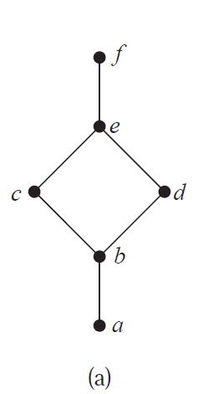
Lattice – Example 1
Determine whether the posets represented by each of the Hasse diagrams in Figure below are lattices.
The posets represented by the Hasse diagrams is a lattice
Because in poset every pair of elements has
both a least upper bound and a greatest lower bound.
This is a lattice.

Slide 9
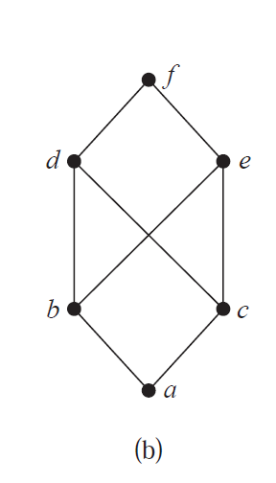
Lattice – Example 2
Determine whether the posets represented by each of the Hasse diagrams in Figure below are lattices.
The posets represented by the Hasse diagrams is not a lattice.
Because in poset pair = { b, c} does not have a least upper bound.
This is not a lattice.

Slide 10
Bounded Lattice
A lattice L is called a bounded lattice if it has greatest element 1 and a least element 0.
A lattice L is bounded if it has both an upper bound,
denoted by 1, such that x ≪1 for all x ∈ L and a lower bound, denoted by 0, such that 0 ≪ x for all x ∈ L.

Slide 11
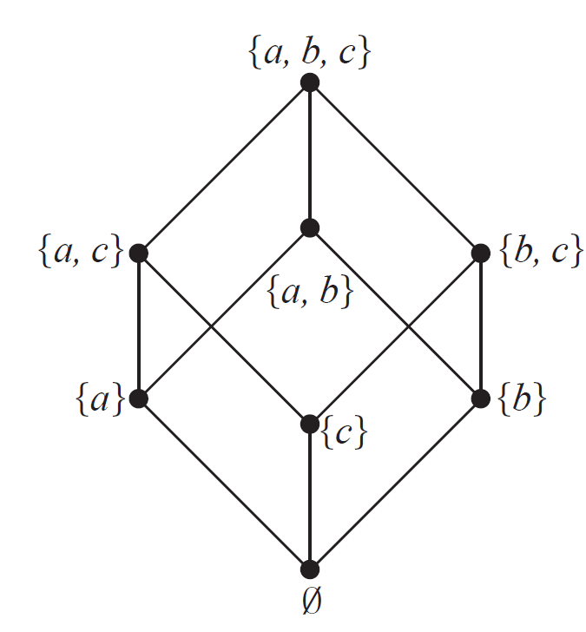
Bounded Lattice – Example 1
The power set P(S) of the set S under the operations of intersection and union is a bounded lattice since ∅ is the least element of P(S) and the set S is the greatest element of P(S).

Slide 12
Bounded Lattice – Example 2
The set of +ve integer (𝑧⁺,≤) under the usual order of ≤ is not a bounded lattice since it has a least element 1 but the greatest element does not exist.

Slide 13
Distributive Lattice
Let L be a lattice. Define the meet (∧) and join (∨) operation by x ∧ y = glb(x, y) and x ∨ y = lub(x, y).
A lattice <A,≤> is distributive iff following holds
for every a, b, c ∈ A: a ∧ (b ∨ c) = (a ∧ b) ∨ (a ∧ c).

Slide 14
Distributive Lattice – Example 1
Give an example of a lattice that is not distributive.
The diamond lattice M3 is non-distributive:
LHS= x ∧ (y ∨ z) =
x ∧ 1 = x
RHS= (x ∧ y) ∨ (x ∧ z).
= 0 ∨ 0 =0
x ∧ (y ∨ z) ≠ (x ∧ y) ∨ (x ∧ z).
x≠ 0
LHS ≠ RHS
1
x
y
z
0

Slide 15
Distributive Lattice – Example 2
Give an example of a lattice that is distributive.
Take,
LHS= {a} ∧ ({a, b} ∨ {b, c}) =
{a} ∧ {a, b, c} = {a}
RHS= ({a} ∧ {a, b}) ∨ ({a} ∧ {b, c}).
= {a} ∨ ∅ = {a}
{a} = {a}
LHS = RHS

